Slide 1
A Presentation on
An Efficient Deep Learning Approach for Brain Tumor
Segmentation Using CNN
URL: https://iopscience.iop.org/article/10.1088/1757-899X/981/2/022012/pdf
Authors: Dr. M. Jogendra Kumar, Dr. N. Raghavendra Sai, and Dr. Ch. Smitha Chowdary
Presented by: Group 10
Group Members:
19273002 Sabira Roshid Toma
20266003 Sanowar Hossain Raja
20266019 Humayra Ferdoushi
20366019 Shafayet Mahmud
22166024 Tamanna Jahan Jerin
22166027 Md. Manik Hossain
22166033 A.K.M. Salman Hosain
22173006 Sifat Moonjerin

Slide 2
A Presentation on
An Efficient Deep Learning Approach for Brain Tumor
Segmentation Using CNN
URL: https://iopscience.iop.org/article/10.1088/1757-899X/981/2/022012/pdf
Authors: Dr. M. Jogendra Kumar, Dr. N. Raghavendra Sai, and Dr. Ch. Smitha Chowdary
Presented by: Group 10
Group Members:
19273002 Sabira Roshid Toma
20266003 Sanowar Hossain Raja
20266019 Humayra Ferdoushi
20366019 Shafayet Mahmud
22166024 Tamanna Jahan Jerin
22166027 Md. Manik Hossain
22166033 A.K.M. Salman Hosain
22173006 Sifat Moonjerin

Slide 3
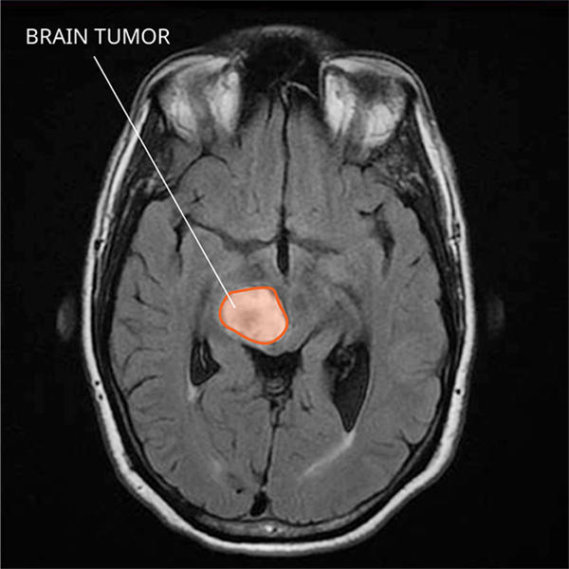
Abstract
Brain tumors can show up in any part in the brain and can be of any size, shape, and nature, creating the need for a versatile, high breaking point profound Neural Network
BraTS cerebrum tumor division challenge dataset was used
Fix wise division procedure was utilized
Accuracy of 98% in test set data
CNN utilized to locate gliomas
Deep NN to discover the shrouded units in gliomas
Fig: MRI of a diffuse midline glioma in the brain
Source: National Cancer Institute https://www.cancer.gov/rare-brain-spine-tumor/tumors/diffuse-midline-gliomas
A.K.M. Salman Hosain, ID: 22166033

Slide 4
Introduction
It will be a atypical increment of an its inside the brain. The brain Tumors maybe two:
Malevolent (cancerous) or,
Benevolent (non-cancerous)
Increasing the weight of the brain can damage the brain and it can be life threatening. Brain Tumor described as:
Essential and
Optional
An essential brain tumor ascends in our brain, quite a bit of them are big hearted and An optional brain tumor, this may be occurred from other organ like bosom or lung.
2. Can be distinguished by restorative imaging, Therapeutic tissue will be used for treatment and for clinical diagnosis and diagnosis. Imaging techniques through radiology are included.

Slide 5
Introduction
3. MRI is used to create clinical imaging techniques in humans. It will be habitually used while treating foot, lower leg and brain tumor. X-ray or CT may be performed to diagnose brain tumors at an early stage. Because radiation harmful to human body.
4. Consequently brain tumor reasons strokes, So it remains to be seen whether the drug will improve life expectancy in the case of brain tumors.
5. Ordinarily, restorative images have low quality perceive the tumor because of commotions
Tamanna Jahan Jerin ID: 22166024

Slide 6
Literature Survey
Different competent and computationally basic adaptable change cancelers for electroencephalogram update
Grammatical Bee Colony (GBC) is proposed
Regenerative pixel model and tumor locus calculation
Brain tumor segmentation framework based on outlier detection
Sabira Roshid Toma, ID: 19273002

Slide 7
Literature Survey
Watermarking strategy in E-clinical thought application subject to the hybridization of weight and cryptography figuring with two phases:
1. Watermark Implanting Cycle
2. Watermark Extraction Measure
Proposing deal with interpretation, scaling, turn with variable foundations and covering surface mix as an earlier breaking point for level set progress. Forming proposes a couple of execution measures among which F-measure and Object level consistency.
A nonlinear dimensionality decay procedure is applied to a high-dimensional scale-invariant segment change portrayal of the fundus picture. NDR methodology gives a low-dimensional segment vector for sore depiction in fundus pictures.
Md. Manik Hossain, ID: 22166027

Slide 8
Usage
PRE PROCESSING In this force normalization procedure, a lot of power accomplishments would take in for every social event from the arrangement sorted out. The power normalization might be done by straightly changing the guideline powers between two spots of enthusiasm under those relating found accomplishments.
CONVOLUTIONAL NEURAL NETWORKING CNN may are utilized to accomplish a bit bounce forward results and win indisputable burdens.
Presenter: Sifat Moonjerin | ID: 22173006/22166021

Slide 9
Usage
POST PROCESSING
Control volumetric obliges toward cleansing get-togethers inside the division got by the CNN that are more minor over a predefined edge increment.
Image of Sharpening
Feature Extraction
Detection of Edge
Sanowar Hossain Raja, ID: 20266003

Slide 10
Results
Picture making sure about pictures are gotten utilizing MRI look.
The affiliations will rely upon network degree and its field of perspective.
Events of divisions got with cross-support
indicating the impact of all parts of the proposed technique.
HGG
LGG
tumor class
MATLAB
Humayra Ferdoushi, ID: 20266019

Slide 11
Conclusion
Shafayet Mahmud, ID: 20366019

Slide 12
Abstract
Brain tumors can show up in any part in the brain and can be of any size, shape, and nature, creating the need for a versatile, high breaking point profound Neural Network
BraTS cerebrum tumor division challenge dataset was used
Fix wise division procedure was utilized
Accuracy of 98% in test set data
CNN utilized to locate gliomas
Deep NN to discover the shrouded units in gliomas
Fig: MRI of a diffuse midline glioma in the brain
Source: National Cancer Institute https://www.cancer.gov/rare-brain-spine-tumor/tumors/diffuse-midline-gliomas
A.K.M. Salman Hosain, ID: 22166033

Slide 13
Introduction
It will be a atypical increment of an its inside the brain. The brain Tumors maybe two:
Malevolent (cancerous) or,
Benevolent (non-cancerous)
Increasing the weight of the brain can damage the brain and it can be life threatening. Brain Tumor described as:
Essential and
Optional
An essential brain tumor ascends in our brain, quite a bit of them are big hearted and An optional brain tumor, this may be occurred from other organ like bosom or lung.
2. Can be distinguished by restorative imaging, Therapeutic tissue will be used for treatment and for clinical diagnosis and diagnosis. Imaging techniques through radiology are included.

Slide 14
Introduction
3. MRI is used to create clinical imaging techniques in humans. It will be habitually used while treating foot, lower leg and brain tumor. X-ray or CT may be performed to diagnose brain tumors at an early stage. Because radiation harmful to human body.
4. Consequently brain tumor reasons strokes, So it remains to be seen whether the drug will improve life expectancy in the case of brain tumors.
5. Ordinarily, restorative images have low quality perceive the tumor because of commotions
Tamanna Jahan Jerin ID: 22166024

Slide 15
Literature Survey
Different competent and computationally basic adaptable change cancelers for electroencephalogram update
Grammatical Bee Colony (GBC) is proposed
Regenerative pixel model and tumor locus calculation
Brain tumor segmentation framework based on outlier detection
Sabira Roshid Toma, ID: 19273002

Slide 16
Literature Survey
Watermarking strategy in E-clinical thought application subject to the hybridization of weight and cryptography figuring with two phases:
1. Watermark Implanting Cycle
2. Watermark Extraction Measure
Proposing deal with interpretation, scaling, turn with variable foundations and covering surface mix as an earlier breaking point for level set progress. Forming proposes a couple of execution measures among which F-measure and Object level consistency.
A nonlinear dimensionality decay procedure is applied to a high-dimensional scale-invariant segment change portrayal of the fundus picture. NDR methodology gives a low-dimensional segment vector for sore depiction in fundus pictures.
Md. Manik Hossain, ID: 22166027

Slide 17
Usage
PRE PROCESSING In this force normalization procedure, a lot of power accomplishments would take in for every social event from the arrangement sorted out. The power normalization might be done by straightly changing the guideline powers between two spots of enthusiasm under those relating found accomplishments.
CONVOLUTIONAL NEURAL NETWORKING CNN may are utilized to accomplish a bit bounce forward results and win indisputable burdens.
Presenter: Sifat Moonjerin | ID: 22173006/22166021

Slide 18
Usage
POST PROCESSING
Control volumetric obliges toward cleansing get-togethers inside the division got by the CNN that are more minor over a predefined edge increment.
Image of Sharpening
Feature Extraction
Detection of Edge
Sanowar Hossain Raja, ID: 20266003

Slide 19
Results
Picture making sure about pictures are gotten utilizing MRI look.
The affiliations will rely upon network degree and its field of perspective.
Events of divisions got with cross-support
indicating the impact of all parts of the proposed technique.
HGG
LGG
tumor class
MATLAB
Humayra Ferdoushi, ID: 20266019

Slide 20
Conclusion
Shafayet Mahmud, ID: 20366019

